Slide 1
Critiquing a Movie
Step by step…

Slide 2
What is a movie critique?
Movie critiques tell what worked well and what didn’t work well in a movie
What is important for a movie review? What should a critique have?
Have you ever watched or not watched a movie because you read a good or bad movie review or critique?

Slide 3
Movie Review Example
Movie Critiquing example

Slide 4
Step One: Summary
In the first step of reviewing a movie is summarizing the movie:
Plot
Characters
Setting
Genre
This section should not be too long but should tell the audience what the movie was about.
“The movie ‘Lou’ opens up in a present-day kindergarten playground filled with playing children at recess. Lou, the lost and found creature, is revealed after the children go inside… J.J., the bully, is shown as a mean-spirited child who steals the toys of other children…”

Slide 5
Step Two: Story telling
This next step is where you need to analyze how the story and plot matched with the character development, conflict, mood, morality.
Was the character development strong?
How did the mood fit into the plot?
What kinds of morality did the characters show?
Did everything fit together well, or did something seem off or random about the movie?
“J.J. is presented first as an immoral character. Through his interactions with Lou, J.J. struggles to keep what he stole. The conflict between Lou and J.J. is really effective because it allows for the audience to both get some laughs but also understand the later developments in J.J.’s heart… J.J.’s discovery of his bear is perfectly placed and shown…”

Slide 6
Step three: technicalities
In this section, you will need to consider how the music, editing, animation, etc. fits the film.
How does the music sound? Does it help the mood, or is it distracting to the plot?
How is the acting? Is it filled with emotion, or is the acting bland?
How is the lighting/filming style/animation style?
“Lou has a really good ability to inspire and catch the imagination of the audience… The music is well written and helps the audience to understand every emotion of J.J. and Lou… The animation style is light and colorful except for J.J.’s flashback which helps to understand the plot and sets the mood of the film as being optimistic…

Slide 7
Step Four: thoughts and emotions
In this section, you will tell us how you feel about the film.
Did you have a positive or negative opinion about the film? Why?
Would you recommend it to others? Why?
What ranking would you give this movie?
“Lou is a delightful film that is fun for the whole family. After watching Lou, I felt inspired and encouraged by all aspects of the film. The animation and music combined really allowed for me to enjoy this movie. This is a must-see film. I highly recommend this film to others if they want a little bit of encouragement in their lives…”

Slide 8
Step Five: Conclusion
Finally, take one minute to finish out your thoughts.
Any final words?
Give a final sentence about the movie that leaves a good impression.
It is good to start with “In conclusion,…” or another transition like “Finally,…”
“Finally, Lou is a very fun yet powerful film. Pixar, in making the short film, really did a great job. Lou is an excellent example of what an animation movie should strive for, and if Pixar makes anymore animation films like this one, families and homes will be graced with positive morals and sound cinematographic gold.”

Slide 9
Useful Phrases
There are many useful phrases that you can use to describe movies:
Actors/Characters: “X adds a lot to the film…”
Plot: “When X reached its climax…” “X aroused curiosity very well with its…”
Etc.
Use the guide to find and use useful phrases for your review. What good phrases can you find?

Slide 10
Agreeing and Disagreeing
Part of critiquing involved agreeing and disagreeing. Here are some common expressions:
Agreeing:
I agree with you that…
You make a good point that...
I like how the movie did…
Disagreeing:
Although you raise a good point, I would like to point out that…
On the contrary to your idea, I would like to say that…
I don’t like how the movie went and did…
It’s important to always try to be nice. Try to avoid slang. (Tell me about it! – meaning you strongly agree)

Slide 11
Movie Review Language Game
Can you win?

Slide 12
Talk or Die!!!
HOW TO PLAY (phone timer and game piece)
You must talk about the topic for the time you roll continuously. If you are successful, you live (you keep your position, the turn passes to next person). BUT: If you pause for more than three seconds….
YOU DIE!!!
(move back to previous space, the turn passes)
Step One: Roll the dice to see how far you will go.
Step Two: Roll the dice again to choose time limit:
1) 20 sec.
2) 25 sec.
3) 30 sec.
4) 35 sec.
5) 40 sec.
6) 45 sec.
Step Three:
If you role 1-3, you have 5 seconds to think. If you role 4-6, you have 10 seconds to think.
Step Four:
Have fun!

Slide 13
Asking good questions
When talking about a review with someone, it is good to ask some thoughtful questions:
Do you think the two alien’s personalities fit well for the comedy? Why or why not?
Did the music fit well with the storyline and humor? Why or why not?
What ranking would you give this short film? Why?
Did the overall mood of the film match your expectations? Why or why not?
Ask questions that allow for the other person to fully explain their ideas (“why or why not”)
Think about important parts of the movie, not random parts of the movie

Slide 14
Tips for asking questions
Ask HOW and WHY questions
These allow for more explanation
Who, what, when, and where questions just have to do with the facts
It is ok to ask a “Did” or “Do you think” question followed by “why”
Use phrases like “Do you think that…” or “How did you feel when…”
Consider how the movie actually was versus how the movie was intended to be by the directors and makers of the movie

Slide 15
Lifted
By pixar

Slide 16
Historical Dramas and Societal Issues
What do they have to do with each other…

Slide 17
Societal Issues in Movies
In the past, we talked about how every movie has a message or morality.
Many times, especially recently, movies have a message about society and the problems that are there and how they can be solved. What are some examples:
Income Inequality/Class Differences
Disabilities
LGBT
Government and Corruption
Selfishness and Greed
Women’s Issues

Slide 18
Societal Issues in Movies
How do we know the message and societal issue that is being dealt with in a movie?
It may be obvious
Look at the conflict
Look at the character who struggles and the other characters
Historical dramas deal with societal issues specifically. What were the societal issues in:
Titanic?
Schindler’s List?
12 Years a Slave?
Les Misérables?
How did these movies show these issues?

Slide 19
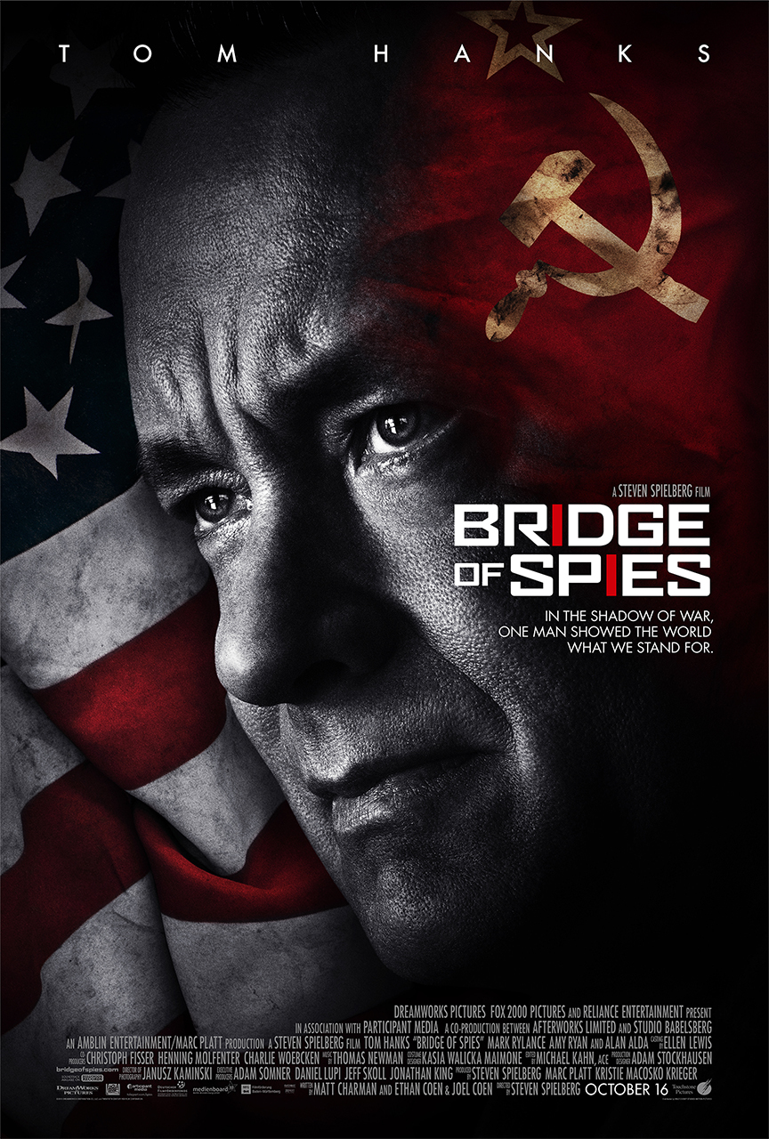
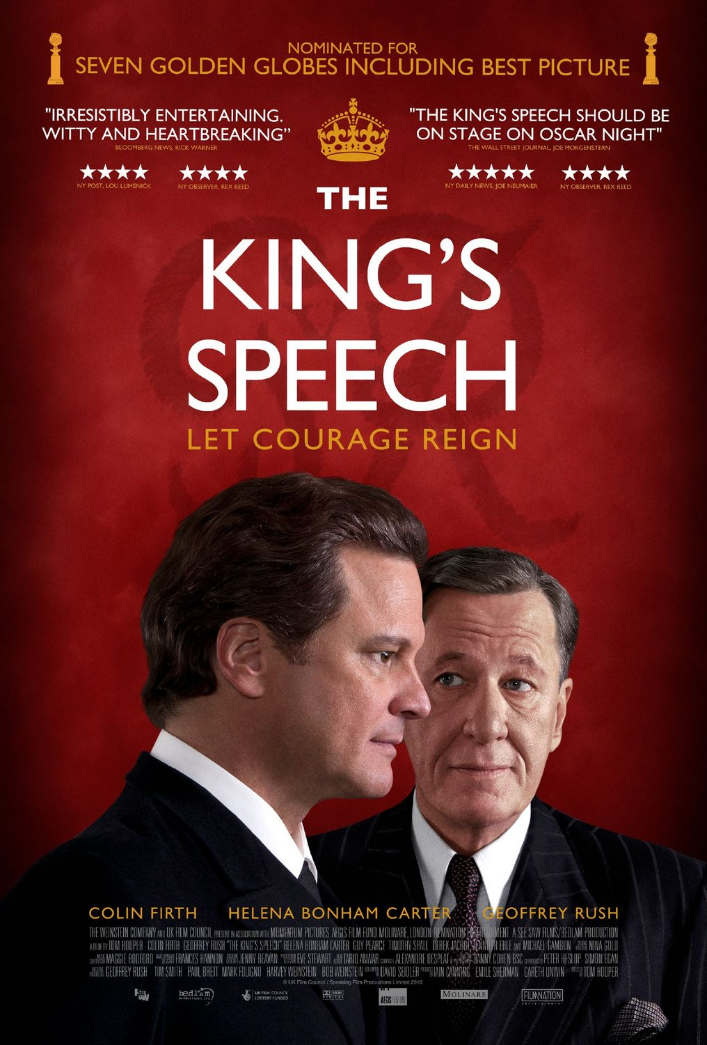
Choose a movie

Slide 21
Presentation Two Critique Outline
Step One: Summary – 1 minute
Step Two: Story Telling – 2 minutes
Step Three: Technicalities – 2 minutes
Step Four: Thoughts and Emotions – 3 minutes
Step Five: Conclusion – 1 minute
Question and Answer – 1 minute
Each group will have to answer one question from other groups. Groups not presenting will write a question to ask the other group when the presentation is over.

